Slide 1
Towards Terminology Services: experiences with a pilot web service thesaurus browser
Doug Tudhope & Ceri Binding
Hypermedia Research Unit
University of Glamorgan
DC-2005

Slide 2
Presentation
FACET Project
  Faceted Knowledge Organisation Systems (KOS)
  Semantic expansion
  Web Demonstrator
Pilot Terminology Services
  Need for standard representations and API
  SKOS API
  Web service thesaurus browser
    Limitations
    Caching
    Demonstration
Conclusions – future developments

Slide 3

FACET - Faceted Access to Cultural hEritage Terminology
FACET - a collaborative project investigating the potential of semantic term expansion in retrieval
Aims:
Integration of thesaurus into the interface
Semantic term expansion and matching function
taking advantage of facet structure
http://www.comp.glam.ac.uk/~FACET/
Notes:
While the potential of the semantic relationships between index terms in faceted thesauri is widely recognised, it has yet to be fully realised in retrieval.
Research challenges include the ‘vocabulary problem’ –
differences in choice of index term at different times by indexers and searchers. Indexer and searcher may be operating at different levels of specificity, and at different times an indexer(s) may make different choices from a set of possible term options. While conventional narrower term expansion may help in some situations, a more systematic approach to thesaurus term expansion has the potential to improve recall by allowing imprecise matching between query and media item,

Slide 4
FACET Collaborators
Research Council Funding: EPSRC 3 years
National Museum of Science and Industry (NMSI):
National Railway Museum and Science Museum Collections Database
J. Paul Getty Trust
Art and Architecture Thesaurus (AAT)
Museum Documentation Association (MDA)
Railway Thesaurus
Canadian Heritage Information Network (CHIN)
Advisors
Notes:
Focusing on the AAT but techniques will be general
Can apply to other thesauri
eg mda Railway terminology thesaurus

Slide 5
Faceted Knowledge Organisation Systems
Faceted classifications based on primary division
into fundamental, high-level categories (facets)
Compound descriptors (multi-concept headings) are synthesised
by combination of terms from limited number of fundamental facets
In constructing AAT, adjectival noun phrases very common:
e.g. painted oak furniture
“Rather than enumerate the nearly infinite number of object and subject descriptions needed by thesaurus users, the AAT decided to pursue the building blocks of these descriptors in the form of a faceted vocabulary”
(Guide to Indexing and Cataloging with the Art & Architecture Thesaurus)

Slide 6
Matching Problem
“The major problem lies in developing a system whereby individual parts of subject headings containing multiple AAT terms are broken apart, individually exploded hierarchically, and then reintegrated to answer a query with relevance”
(Toni Petersen, AAT Director)
Query: mahogany, dark yellow, brocading, Edwardian, armchair
Descriptor: oak, light yellow, crests, ovals, brocade, Victorian, Carver chair
Potentially extra / missing / partially and non-matching terms

Slide 7
FACET Web Demonstrator
illustrates thesaurus based semantic query expansion in a prototype Web application
Not rely on pre-built static HTML pages -
thesaurus content is generated dynamically
Intended more as an exploration of FACET research outcomes as dynamically generated Web components than a general interface but suggestive of possible interface components
http://www.comp.glam.ac.uk/~FACET/webdemo/

Slide 8
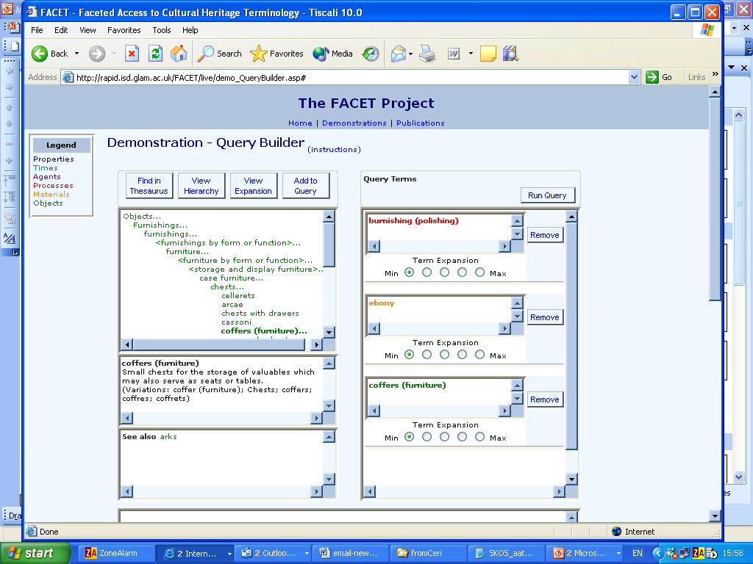
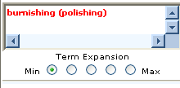
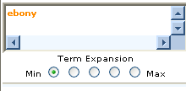
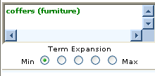
FACET Web Demonstator

Slide 9
Some lessons learned
Results from FACET show potential of faceted KOS for
  Query expansion (ranked results based on semantic closeness)
  Semantic expansion as a browsing tool when wishing to use KOS behind the scenes
Web demonstrator first step
  Based on custom API
  KOS and database on same server (but need not be)
  How to generalise these techniques?
➔ need for
Common KOS representations and APIs
for general terminology (KOS) services

Slide 10
SKOS API
SKOS Core (RDF/XML) Schema and SKOS API deliverables of SWAD-Europe Thesaurus Activity - http://www.w3.org/2001/sw/Europe/reports/thes
SKOS API designed to provide programmatic access to thesauri and related KOS in SKOS Core
Example SKOS API calls
  getConcept (uri)
  getConceptsMatchingKeyword/Regex (string)
  getAllConceptRelatives (concept)
  getSupportedSemanticRelations
  getAllConceptRelatives (concept, relation)
  getAllConceptsByPath (concept, relation, distance)

Slide 11
Pilot KOS Browser Client Web Service
Developed pilot to work with DREFT server as an initial experiment with the SKOS API, a 'rich client' browser displaying details for thesaurus concepts via web service calls
Uses GEMET - GEneral Multilingual Environmental Thesaurus
DREFT demonstration web services server based on SKOS API developed at ILRT, Bristol University http://www.w3.org/2001/sw/Europe/reports/thes/dreft/
Only a subset of SKOS API calls were available at time of work due to local requirements
So we investigated possibilities with just 2 API calls

Slide 12
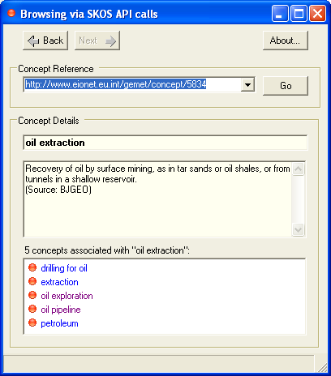
Pilot SKOS API Web Service Browser
getConcept
getAllConceptRelatives
show semantically connected
concepts but not relationships
Navigation history and
local cache of retrieved concepts
implemented
API needs more work
but is a basis for web services

Slide 13
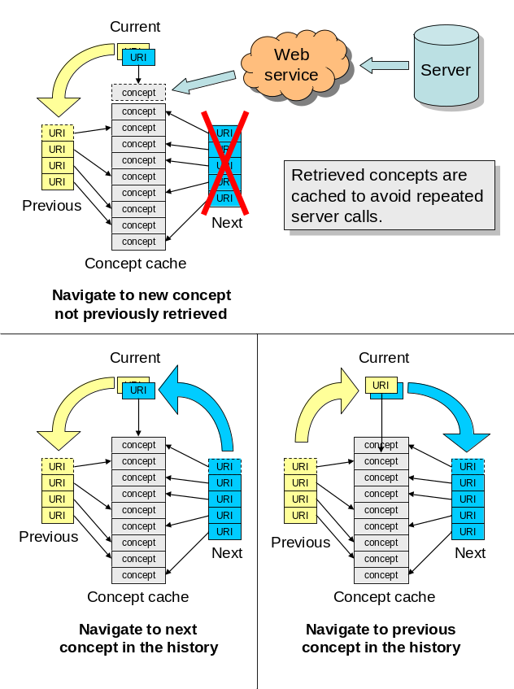
Caching
Thesaurus data
relatively static -
change unlikely
during a session
Caching of concepts helps prevent unnecessary repeated server calls.
Implementation of concept caching made a significant difference to apparent speed of operation

Slide 14
Suggestions for further development of API
Pilot suggests that SKOS API can support client applications of this type.
Suggestions
A single call available for the display of a concept and its directly related concepts - currently two separate server calls necessary
Return relationship information with all calls
Calls returning a list of concepts, related by a relationship should return a structured list, identifying the level of expansion from the initial concept

Slide 15
Case for KOS-specific protocols
Augmented formal KOS (ontologies) in applications requiring logic-based reasoning may be implemented via triple store and general semantic query languages such as SPARQL.
On the other hand,
Strong case for KOS-specific protocols (such as SKOS API) and dedicated server implementations
  for terminology services with a strong interactive component,
  given foreseeable bandwidth limitations
  builds on previous NKOS work and use cases (ADL protocol)
SKOS API remains independent of implementation details. Intended as web service calls but need not be.

Slide 16
Future issues
More complex services as API protocol elements:
more advanced natural language functionality
cross-mapping provision
data-dependent filters (such as number of postings)
semantic expansion as a service (ongoing work)
  different configurations KOS interface displays by single call
  novel interfaces, such as navigation via semantic expansion
  Query expansion for various ranked result query services
  Term suggestion to assist indexing/annotation
  More details:
  KOS at your Service: Programmatic Access to Knowledge Organisation Systems http://jodi.ecs.soton.ac.uk/Articles/v04/i04/Binding/

Slide 17
NKOS Workshop at ECDL 2005 on related theme to this workshop
NKOS Workshop –
Mapping Knowledge Organisation Systems:
User-centred Strategies
  EDCL2005, September 22nd, Vienna
    see http://www2.db.dk/nkos2005/
Selected papers from the NKOS workshop
will be considered for forthcoming special issue
of journal New Review of Hypermedia and Multimedia
along with an open call for papers.

Slide 18
Contact Information
Doug Tudhope
School of Computing
University of Glamorgan
Pontypridd CF37 1DL
Wales, UK
dstudhope@glam.ac.uk
http://www.comp.glam.ac.uk/pages/staff/dstudhope

